Slide 1
Lab # 6 DBMS Sami Ullah

Slide 2
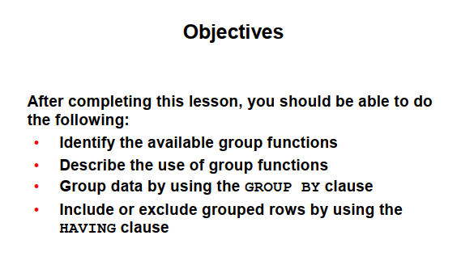

Slide 3
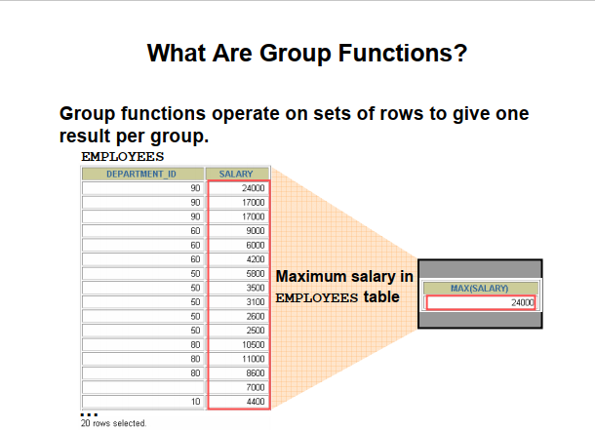

Slide 4
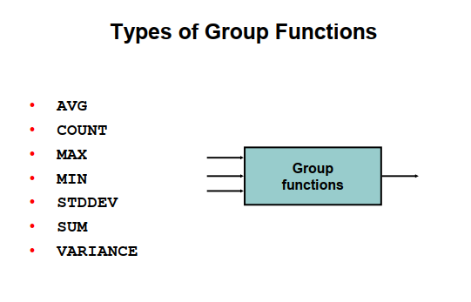

Slide 5
Aggregate Functions
Function | Description | Query Example
AVG(fieldname) | Returns average value of a column | SELECT avg(price)FROM inventory;
COUNT(fieldname) COUNT(*) | Returns number of items in table or queried items | SELECT count(product_id)FROM product; SELECT count(*) FROM product;
MAX(fieldname) | Returns maximum value of a column | SELECT max(price)FROM inventory;
MIN(fieldname) | Returns minimum value of a column | SELECT min(price)FROM inventory;
SUM(fieldname) | Returns total value of a column | SELECT sum(price)FROM inventory;
STDDEV | Returns standard deviation | SELECT stddev(price)FROM inventory;
VARIANCE | Returns the variance | SELECT variance(price)FROM inventory;

Slide 6
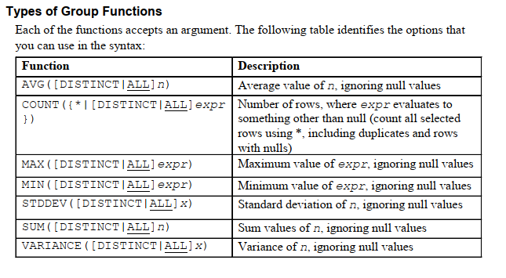

Slide 7
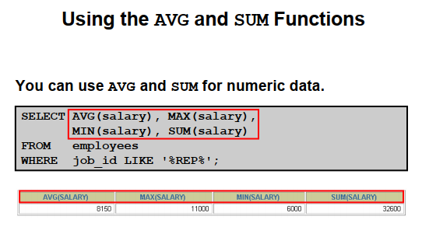

Slide 8
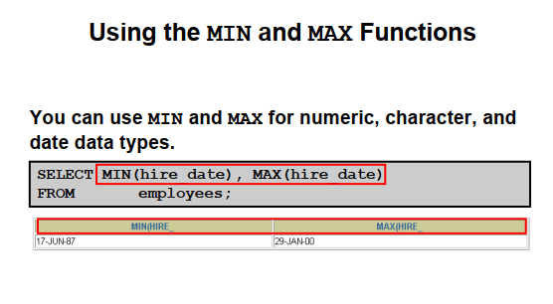

Slide 9
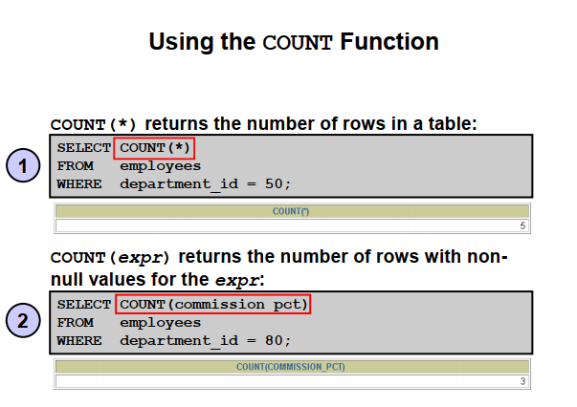

Slide 10
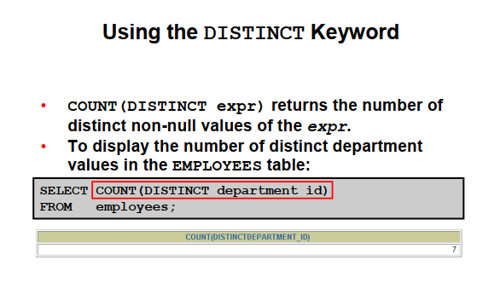

Slide 11
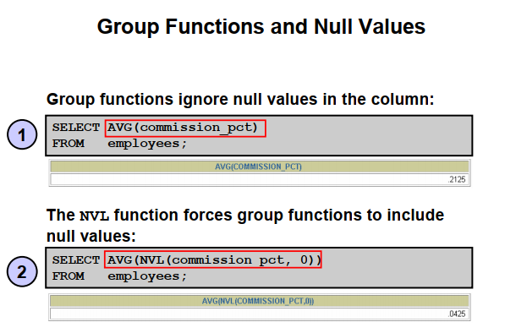

Slide 12
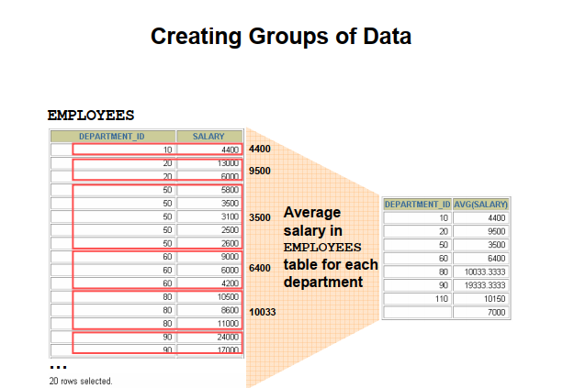

Slide 13
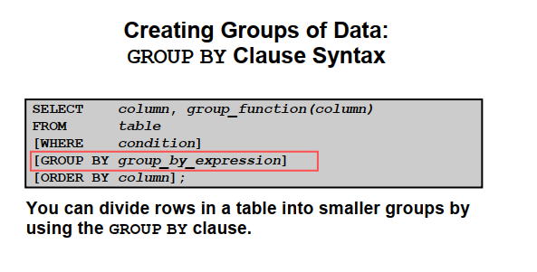

Slide 14
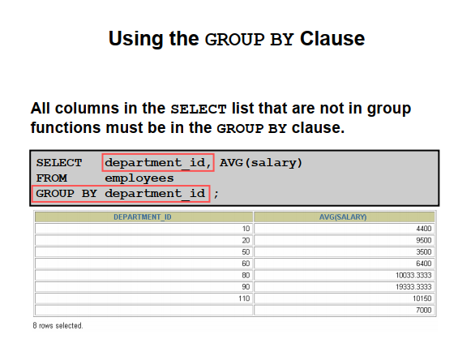

Slide 15
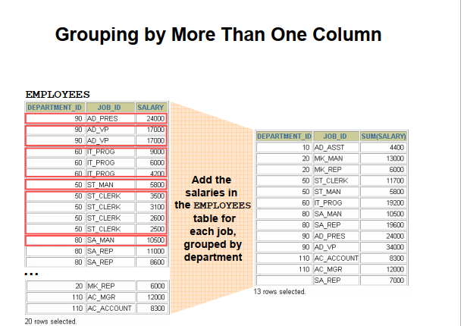

Slide 16
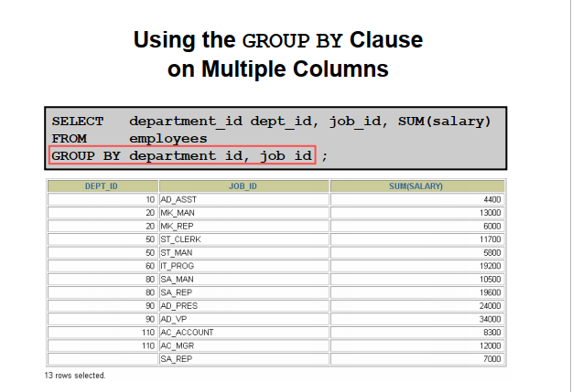

Slide 17
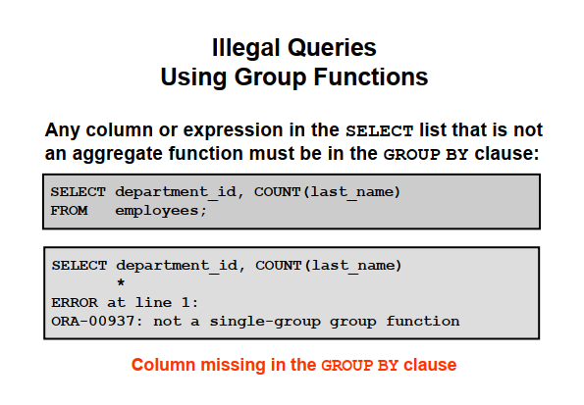

Slide 18
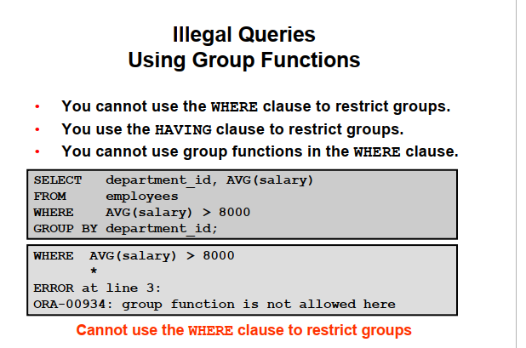

Slide 19
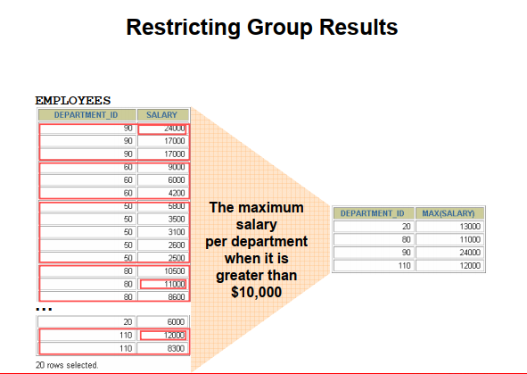

Slide 20
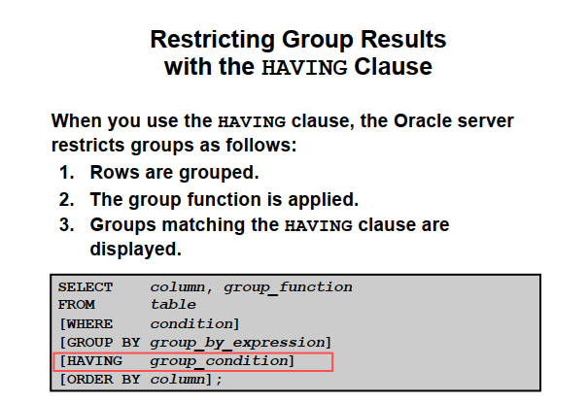

Slide 21
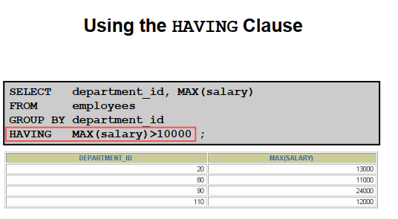

Slide 22
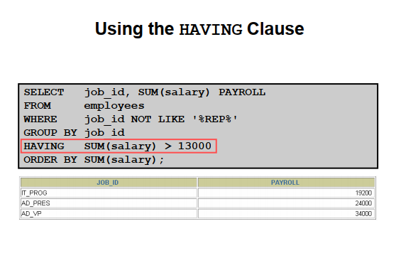

Slide 23
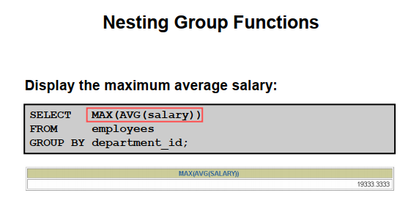

Slide 24
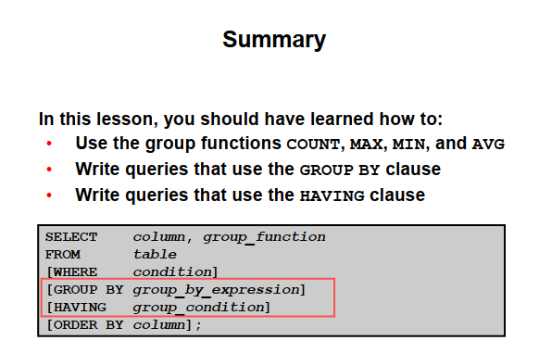

Slide 25
Thank You

